Slide 1
Ethics and Regulation
Gregor Strojin
CAHAI Chair

Slide 2
UNESCO First Draft Recommendation - Final - par. #10
Values play a powerful role as motivating ideals in shaping policy measures and legal norms.
While the set of values […] inspires desirable behaviour and represents the foundations of principles, the principles unpack the values underlying them more concretely so that the values can be more easily operationalized in policy statements and actions.

Slide 3
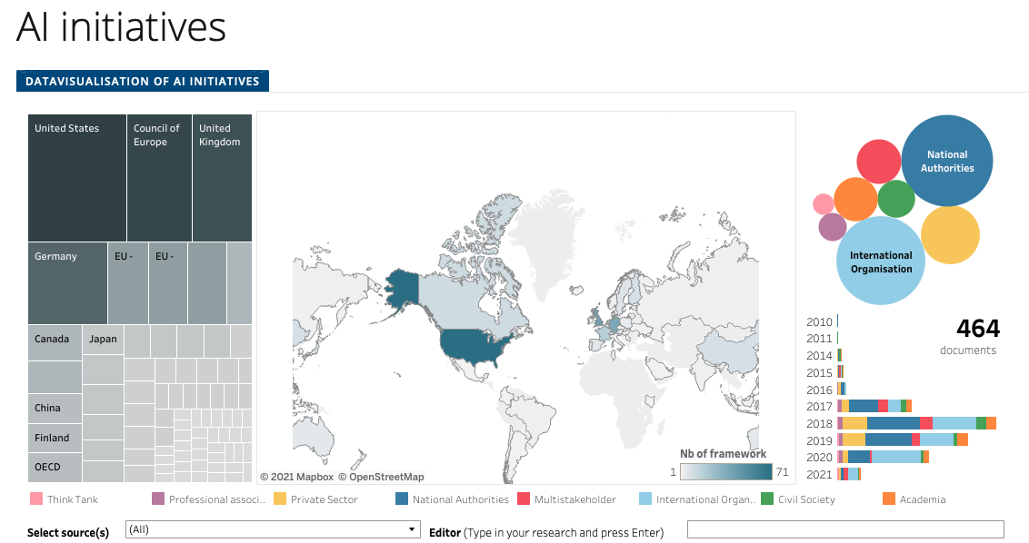
Various AI initiatives
https://www.coe.int/en/web/artificial-intelligence/national-initiatives
OR

Slide 4
CAHAI Multi-Stakeholder Consultation
https://www.coe.int/en/web/artificial-intelligence/cahai-multi-stakeholder-consultation
OR

